Slide 1
Placement Prediction Project
This presentation provides an overview of a machine learning project on placement prediction.
Submitted By:
Amit Pritam Jena (21BCEB47)
Nikhil Bhuyan (21BCEC49)
Amitesh Muduli (21BCED42)
Sai Chandan Majhi (21BCEG16)

Slide 2
Contents
Objective
What Placement Prediction does?
Workflow
Dataset
EDA
Data Preprocessing
Data Visualization
Feature Selection
Model Building
Performance Metrics and Graphs
Conclusion
Future Work

Slide 3
Objective
To develop a predictive system to determine whether or not a student will get placed according to his/her qualifications and performances.
To analyze qualifications, historical performance, and other attributes to get an overall idea about the basic criteria needed for a student to get placed.
To forecast placement opportunities and provide valuable insights into future prospects.

Slide 4
What Placement Prediction Does?
Determines a student's likelihood of getting placed
Helps students prepare for interviews and improve qualifications
Assists educational institutions in improving placement records

Slide 5
Workflow
Start
Data Loading
Data preprocessing
EDA
Splitting the data into training and testing data
Feature selection using correaltion
Data visualisation
Calculating performance metrics and Graphs
Model building
End

Slide 6
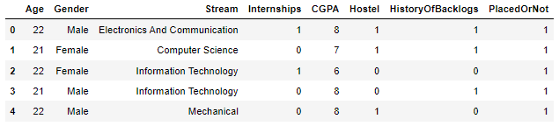
Dataset Used
We have used “Engineering placement prediction” dataset from kaggle. A University Announced Its On-Campus Placement Records For The Engineering Course. The Data Is From The Years 2013 And 2014. The (2966,8) dataset consists of fields such as Age, Gender, Stream, Internships, CGPA, Hostel, History of Backlogs and Placed or not.
The Following Is The College Placements Data Compiled Over 2 years.

Slide 7
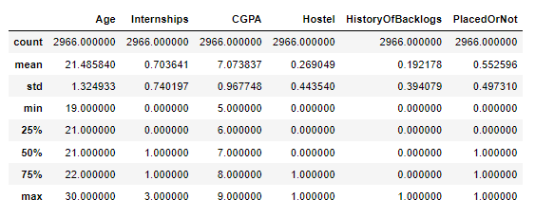
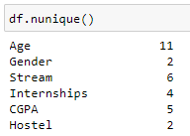
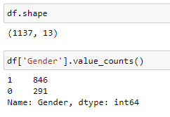

Exploratory Data Analysis
Exploratory Data Analysis (EDA) is a technique used in machine learning to analyze and summarize datasets.
Different data analysis methods were applied to get insights about the dataset such as
.shape(), .describe(), .info(), .nunique(), .isnull().sum(), .duplicated().sum()

Slide 8
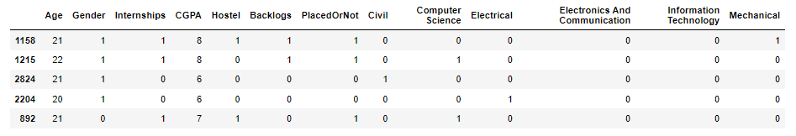
Data preprocessing
Data preprocessing is the process of analyzing, filtering, transforming, and encoding data so that a machine learning algorithm can understand and work with the processed output.
Here in data preprocessing :
All the missing data are handled
Categorical fields (Gender, Stream) are encoded
All the null values are dropped from the dataset
All the duplicate values are dropped from the dataset

Slide 9
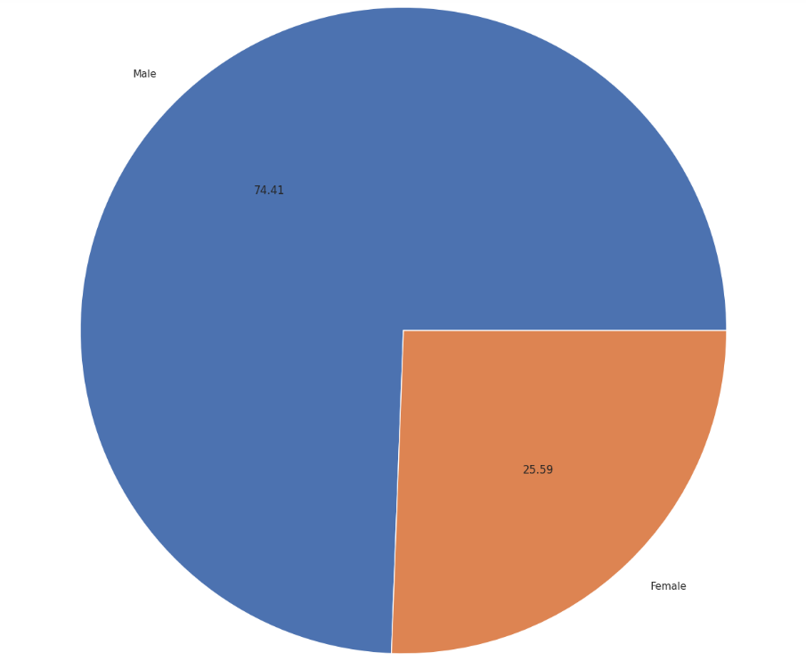
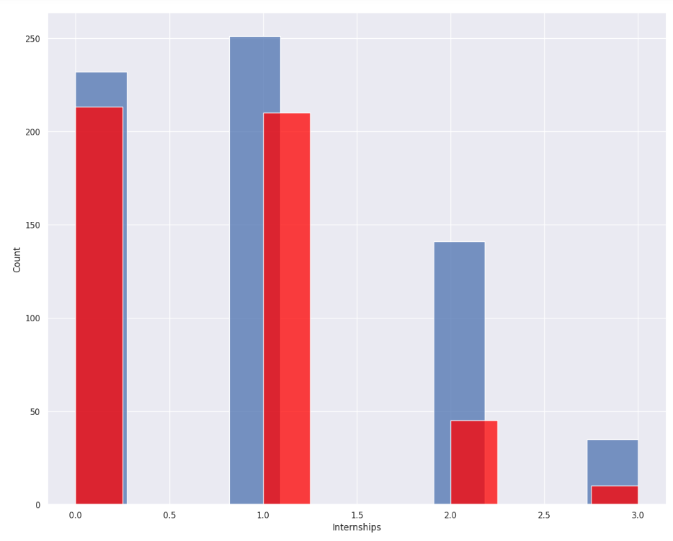
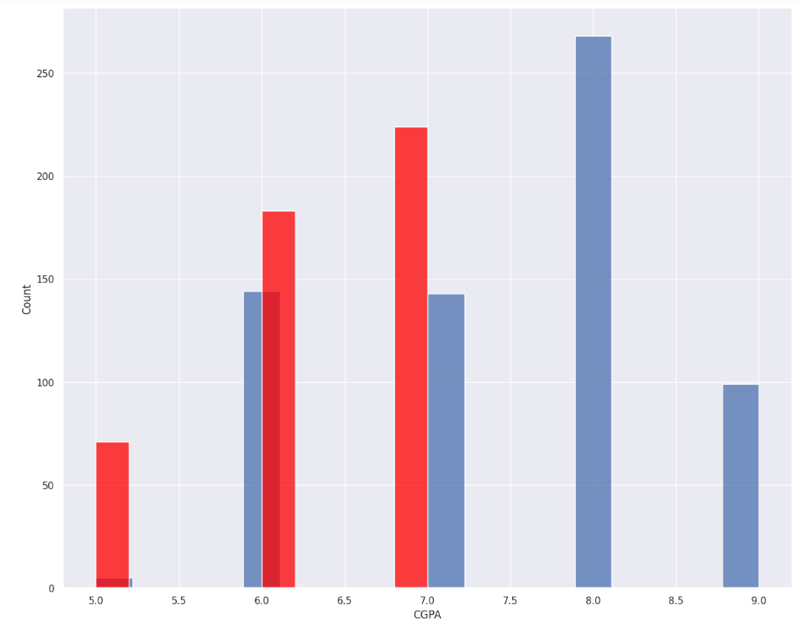
Data Visualization
Data visualization is the representation of data through use of common graphics, such as charts, plots, and infographics.
Male
74.41
25.59
Female
Internships
CGPA

Slide 10
Feature Selection Using Pearson’s Correlation
Feature Selection is the method of reducing the input variable to your model by using only relevant data and getting rid of noise in data.
To avoid overfitting we find correlation among attributes and remove highly correlated attributes from dataset.
The figure in the next slide shows the heat map of the correlation among the attributes.

Slide 11
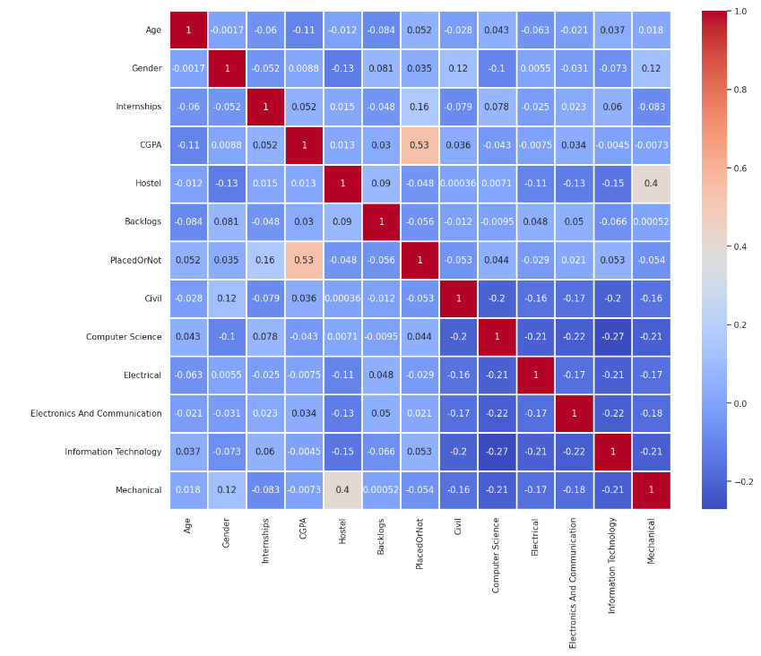

Slide 12
Machine Learning Models Used
Logistic Regression
KNearest Neighbors (KNN)
Naive Bayes
Decision Tree
Random Forest
Support Vector Machine (SVM)

Slide 13
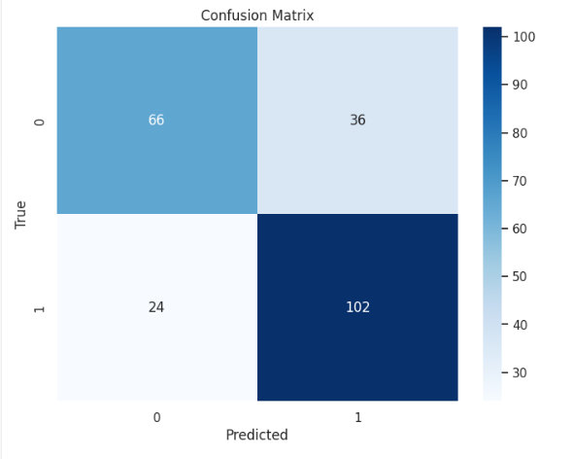
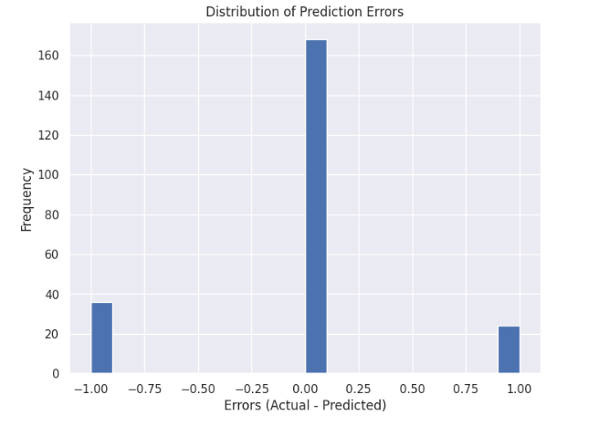
Performance metrics and graphs of Logistic Regression
Accuracy = 0.71
Precision = 0.7391
Recall = 0.8095
F1-Score = 0.7727

Slide 14
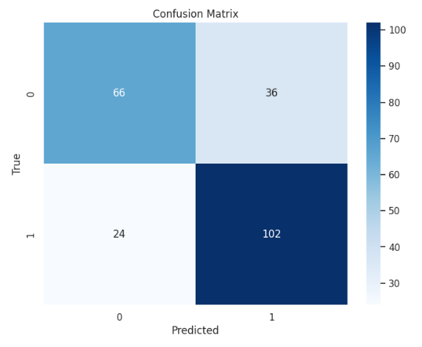
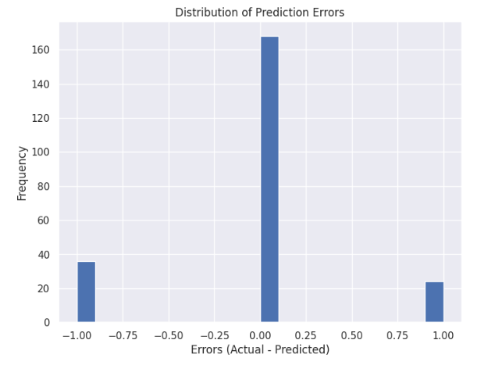
Performance metrics and graphs of Naive Bayes
Accuracy = 0.74
Precision = 0.7391
Recall = 0.8095
F1-Score = 0.7727

Slide 15
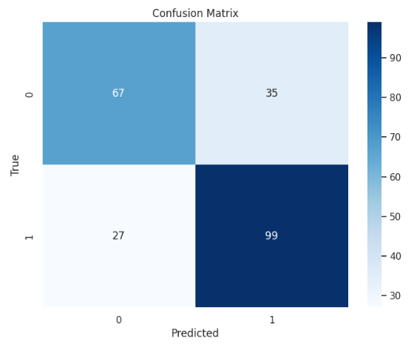
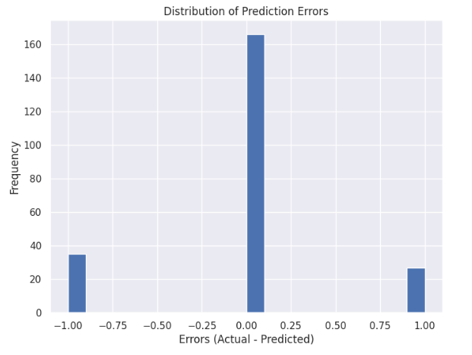
Performance metrics and graphs of KNN
Accuracy = 0.73
Precision = 0.7388
Recall = 0.7857
F1-Score = 0.7615

Slide 16
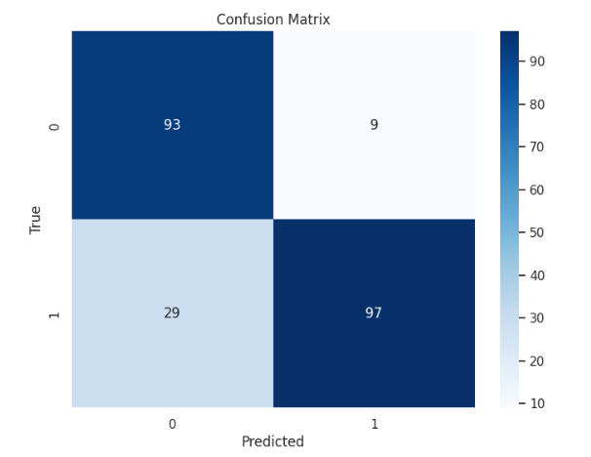
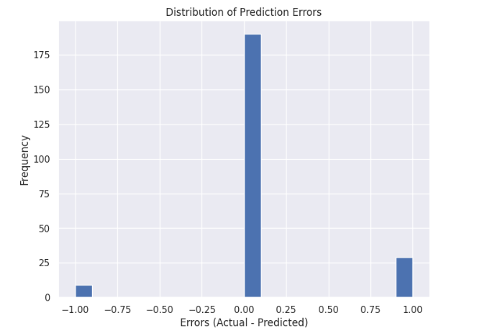
Performance metrics and graphs of Decision Tree
Accuracy = 0.83
Precision = 0.9151
Recall = 0.7698
F1-Score = 0.8362

Slide 17
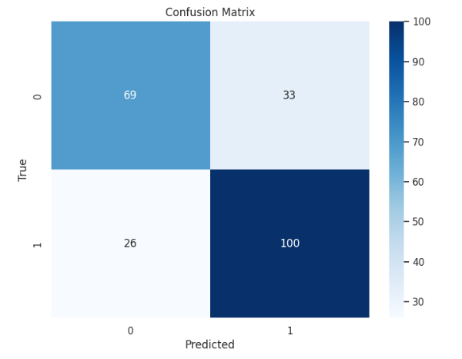
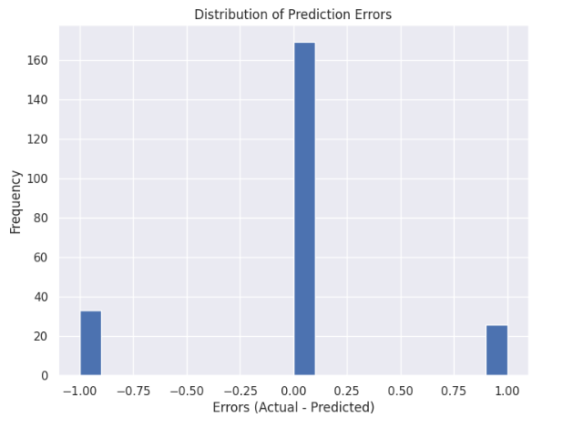
Performance metrics and graphs of Random Forest
Accuracy = 0.74
Precision = 0.7519
Recall = 0.7937
F1-Score = 0.7722

Slide 18
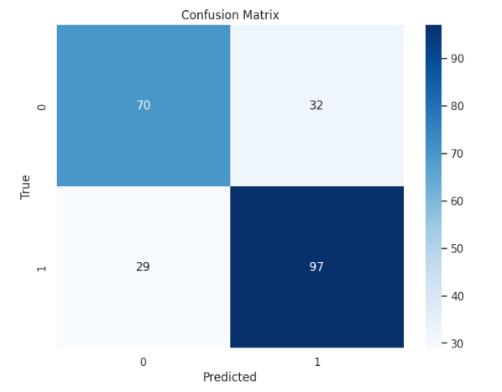
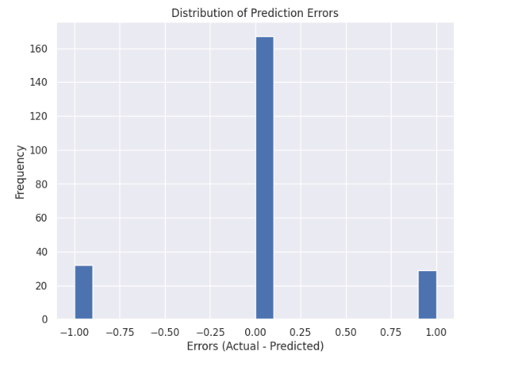
Performance metrics and graphs of SVM Linear
Accuracy = 0.73
Precision = 0.7519
Recall = 0.7698
F1-Score = 0.7608

Slide 19
Conclusion
Hence we conclude that the decision tree classifier model is the best classifier model for this project as it gives the highest accuracy and precision.
It efficiently predicts whether a student will get placed or not based on his/her background data.

Slide 20
Future Work
1. The Summary : This project focuses on how to predict whether or not a student will get placed or not using the data from previous year placements.
2. The limitations of this dataset was it had too many duplicate values which affected the process. A better dataset could have provided us with more accurate prediction model.
In future, if more data is collected from the placement drives then the institute can predict how many of its students are going to be placed in current year every year.

Slide 21
Thank you for your time 😊

